Slide 1
Enhancing Accessibility in Academic Buildings:
A Discrete Event Simulation Approach for Robotic Assistance
By: DIANA GADZHIMUSIEVA, ANASTASIIA GORELOVA, SANTIAGO MELIÁ BEIGBEDER, AND GONZALO LORENZO LLEDÓ
2024
Lecturer: Sina Beyrami

Slide 2
Contents
01
02
Introduction and Background
Discrete-Event Simulation
03
04
Simulation in Academic Building
Results and Conclusion

Slide 3
01
Introduction and Background
In this section, we address the necessity of the problem and review the work that has been done in this field so far.

Slide 4
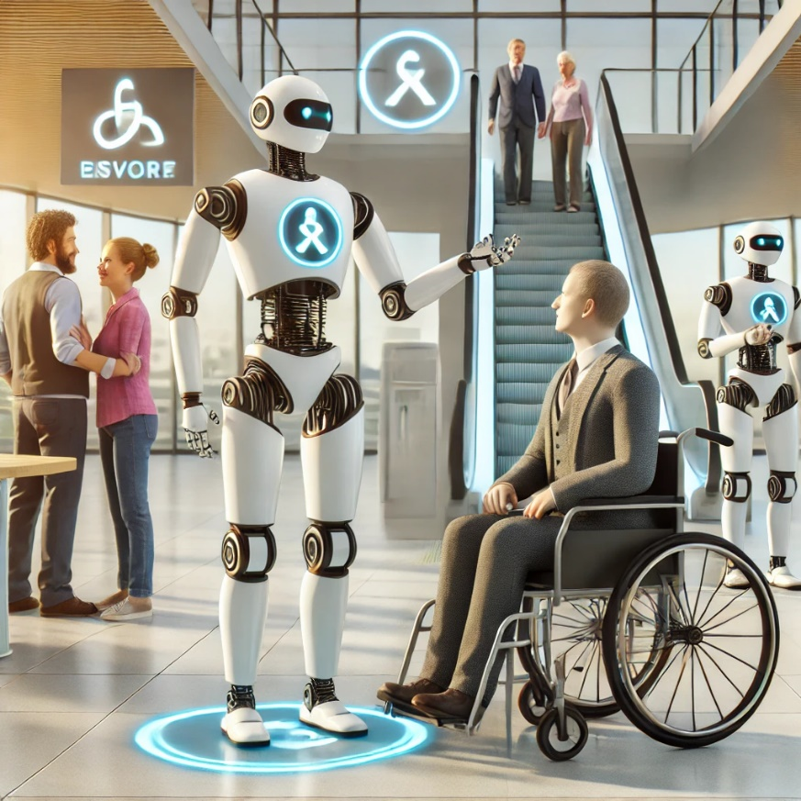
01
Problem Statement
Importance of a barrier-free environment to perform any task for all individuals
People with or without disabilities have the freedom to carry out any type of task autonomously
Public buildings such as academic centers
Personalization is required
Continuous monitoring and assistance
Sensors and actuators → Internet of Things (IoT)
Wearable devices contain information
Devices throughout the building (Smart Building)
Cannot provide a building-wide response
Robots can solve the problem of movement
Reduce risks by obtaining a prediction

Slide 5
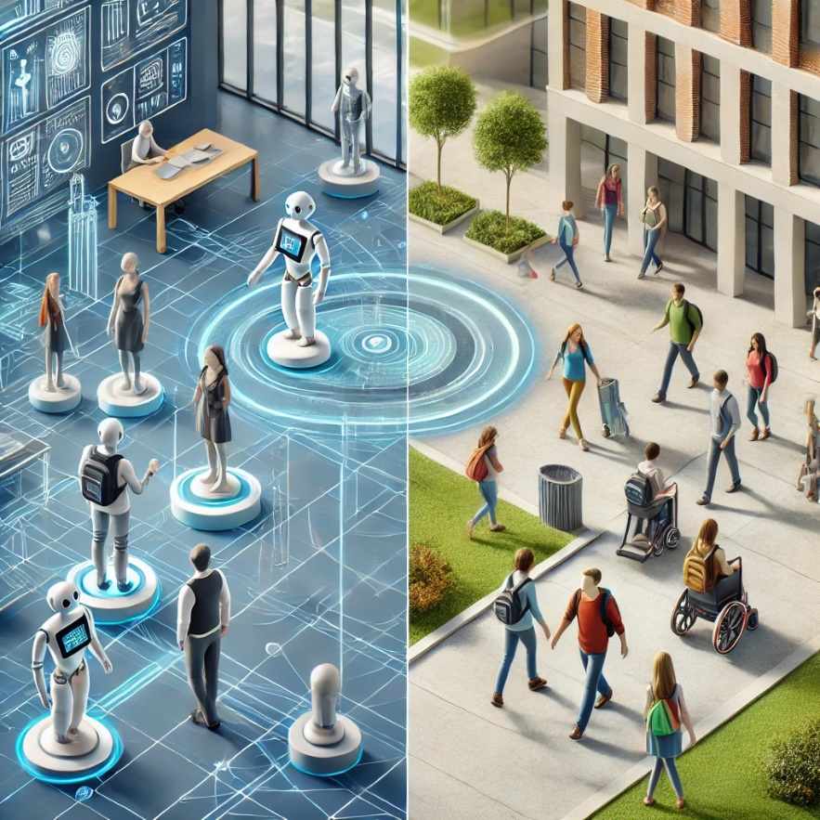
01
Simulator Necessity
A prediction as close as possible to the final result
Virtual representation of complex scenarios
In this case Digital Twins
MoSTBuilding software framework:
Assistant robot
Smart building configuration
Simulation with Digital Twins
Discrete Event Simulation (DES)
Insight into system behavior impact of potential operational strategies
Some resources exhibit expected behavior and others act stochastically
SimEvents and Stateflow toolboxes from the MATLAB Simulink
Two students’ flows in two buildings of University of Alicante
Evaluate whether or not the use of a robot assistant

Slide 6
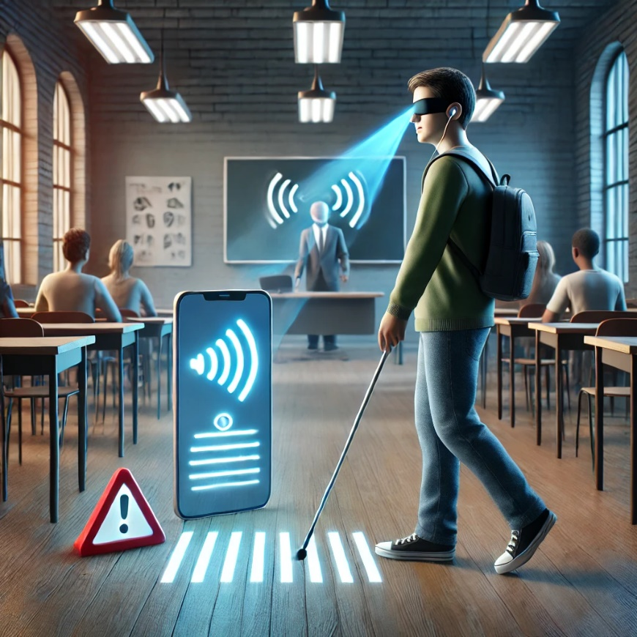
01
NON-ROBOTIC APPROACHES
Some general non-robotic approaches to building accessibility
Definition of Accessibility
Focus on navigation, wayfinding, and avoiding obstacles
AssistMote (WSN wayfinding) hand-held PDAs and Bluetooth
Brain-controlled wheelchair including navigation, path planning,obstacle detection, and UI
V-Eye system for visually impaired people
UniSAS using IoT with Raspberry Pi boards installed on doors and leverages users’ mobile devices
Most studies focus on solutions for only one specific disability
MoSTBuilding framework for all users

Slide 7
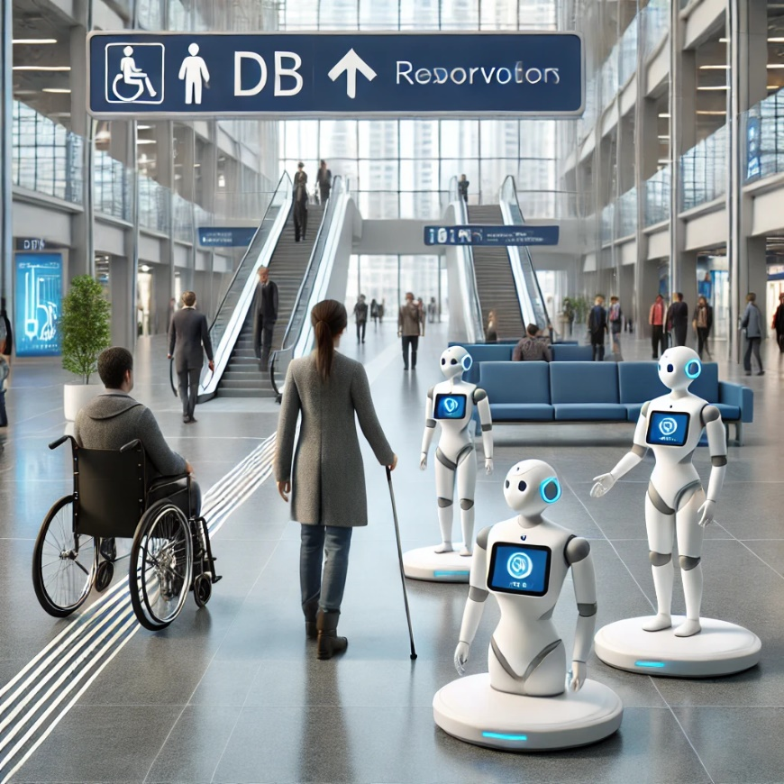
01
ROBOT-ASSISTED APPROACHES
Some general Robot-Assisted approaches to building accessibility
Deep reinforcement learning–based assistive guiding robot for low vision and visually impaired users using designated waypoints in a simulated ward
Wayfinding robot for people with visual impairments in an airport terminal useing a lidar sensor and a camera to detect obstacles and communicates with the user through speech
An innovative system using a camera, a ranging LIDAR, and computer vision to detect possible destinations in an unmapped environment and navigate toward them, avoiding obstacles, tested in a simulated shopping mall environment

Slide 8

01
DES APPLICATION FOR RESOURCE ALLOCATION
How effectively the DES method is utilized to allocate resources in different research areas?
Need for preliminary prediction to determine the possible risks and reveal the effective scenario
DES for:
Evaluating different scenarios
Identifying bottlenecks
Selecting the most effective strategy
Healthcare: use of physicians and nurses, estimation of utilization of beds, nurses, physicians, and the number of patients waiting for surgery
Manufacturing industry: design of a new production line, worker quantities
So essential for flexibility and cost-effectiveness

Slide 9
02
Discrete-Event Simulation
The best approach for simulating our case, which involves student flows, is Discrete-Event Simulation (DES). It enables the analysis of the impact of using assistant robots and the effect of parameter variations on the results.

Slide 10

02
We have modeled 2 scenarios
Involving a robot
Without robot
Purpose
Evaluating whether such a robot in the Polytechnic IV building is suitable for implementation
Simulation before implementation
We choose DES:
The state of the systems changes based on a set of discrete events that occur at specific points in time
DES is a good choice for irregularity and unpredictability
Movement of students from one location to another represents a stochastic phenomenon

Slide 11

02
We use Digital Twin (DT)
Virtual mirrors of physical objects or processes
Better understanding, prediction, and optimization of their performance
Usages of Digital Twins:
Individual objects, such as robots, students, and building IoT devices
Customized to different scenarios
In this case:
Two Student Twins - one with disabilities and the other without.
Robot Twin which has an event-based state machine

Slide 12
03
Simulation in Academic Building
Analysis of the case study (two buildings at the University of Alicante), including the simulation process, the methods employed, and the results obtained from the Discrete-Event Simulation

Slide 13
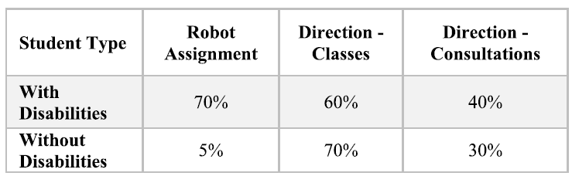
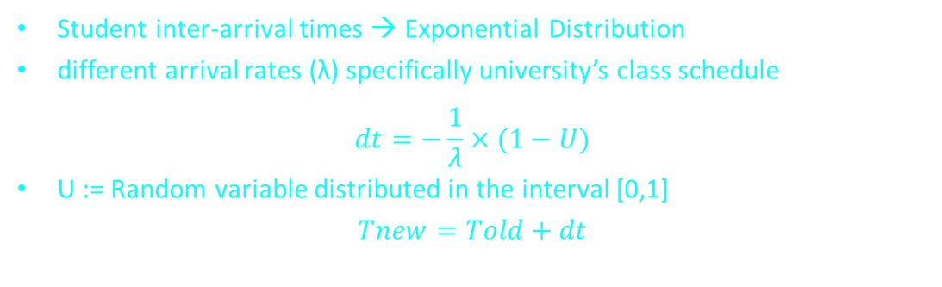
03
First case study
Building IV of the Polytechnic School of the University:
The basement and ground floors comprise 35 classrooms, laboratories, and halls
And the first and second floors: 131 offices and laboratories
Data:
There are a total of 56 students with disabilities: 3% hearing, 11% visual, 53% mental, 9% mobility
Modeling details:
Student inter-arrival times → Exponential Distribution
different arrival rates (λ) specifically university’s class schedule
$$dt=−\frac{1}{λ}×(1−U)$$
U := Random variable distributed in the interval [0,1]
$$Tnew=Told+dt$$

Slide 14
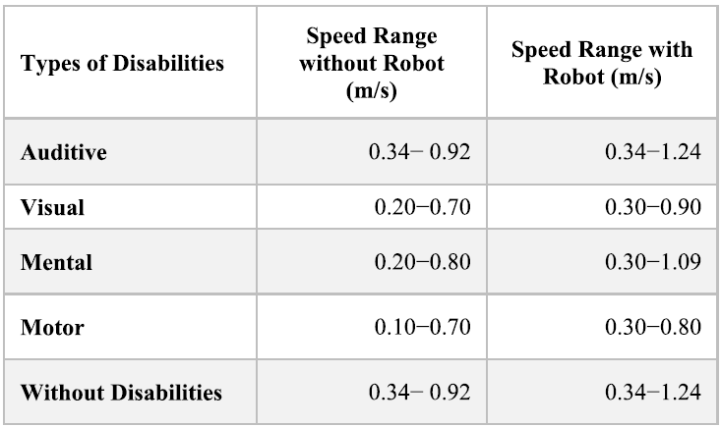

03
Other data details
Speed ranges have been derived from previous studies
In the robot scenario we used average value
For students with motor disabilities electric and manual chairs was considered
Other modeling details:
In calculating distance travel time, probability of error in finding the correct destination is added:
$$T=F ×(\frac{S}{V}+P×M)$$
F for the first attempt without prior knowledge (Randomly go up to 50%)
Probability (P) of making a mistake $≈10\%$
Penalty per mistake (M) based on the average distance

Slide 15
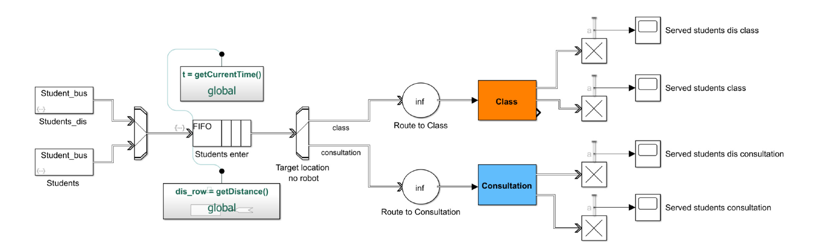
03
STUDENT’ S FLOW WITHOUT ROBOTS
14 and a half hours from 7:30 a.m. to 10 p.m.
Peak hours at the start of classes
Generators create two flows of students with and without disabilities
Combination of two flows of students into a common queue
Two attributes:
Distance between the origin and destination points
Exact start time of the trip
Two subsystems represented by the classroom and consultation blocks
Within each subsystem separate students based on disability status by a switch

Slide 16
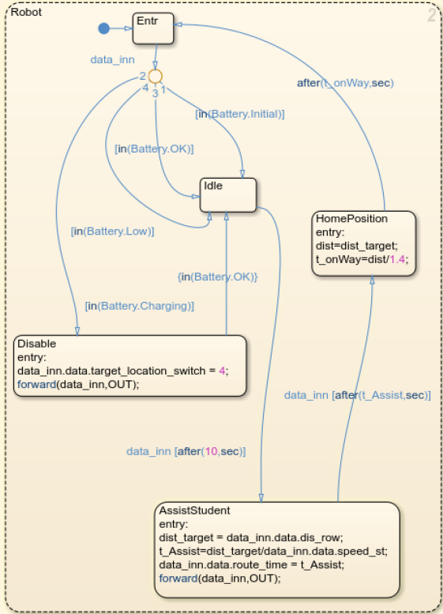
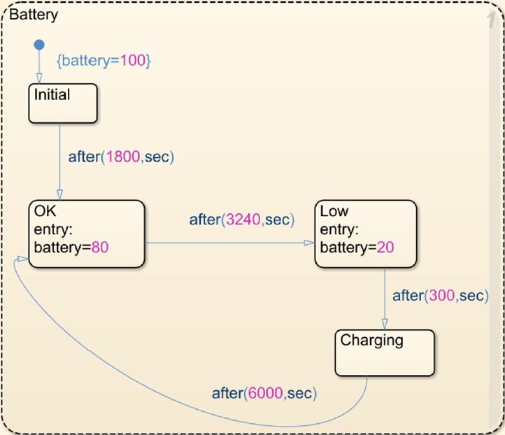
03
STUDENTS FLOW WITH ROBOT ASSISTANT
Essentially comprises the same blocks as the first model
The addition of a Discrete-Event Chart block identified as a Robot Twin
Based on events rather than time intervals → exceptional level of timing precision
DEC of robot’s twin
States:
Active, low battery, and on charge
Charging time depends on temp
DEC of model scenario
Entry point: system verifies the Robot’s battery charge
Robot returns with 1.4 m/s speed
Prioritizing people with disabilities
Models were launched 128 times

Slide 17

03
ENHANCING CREDIBILITY
Another building of the university
Data input sourced from the Faculty of Business and Economics
Significant increase in the number of students at the Faculty of Social Sciences and Law
Totaling 222 students
Greater need of accessibility
The number of entrances, elevators and main staircases is different from the previous building

Slide 18
04
Results and Conclusion
For our ever-lasting friendship, send sincere blessings and warm greetings to my friends whom I miss so much.

Slide 19
04
Simulation process details
Both models were run 128 times
For each iteration:
4 random values for the number of arriving students, class and counseling times
2 values for the student movement speed
Running simulations repeatedly
Reduces the margin of error and improves the reliability
Average time with and without using a robot
Average number of students served by the robot.
Simulation has a length of 14.5 hours
Final goal:
The proposed resource allocation solution is better than the current solution.

Slide 20
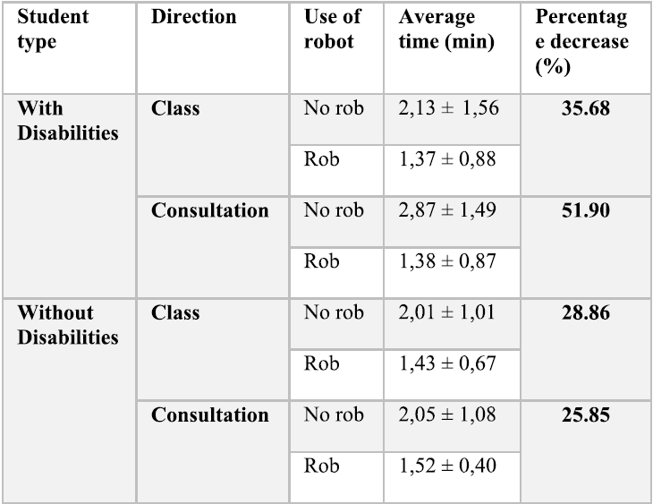
04
Results and interpretation
Results in four discrete groups
Significant decrease in the mean value in all groups
Specifically, the group of disabled students:
Travel time for classes: 2.13 to 1.37 min (35% reduction)
Travel time for consultations: 2.87 to 1.38 min (52% reduction)
Group of students without disabilities:
Travel time for classes: 28% reduction
Travel time for consultations: 25% reduction
Overall:
43% for disabled students and 27% for students without disabilities
Wide spread of the standard deviation:
Variability in student speed
Unfamiliarity with the building
Difference in the range of the destination
Using the robot also reduces the deviation range

Slide 21
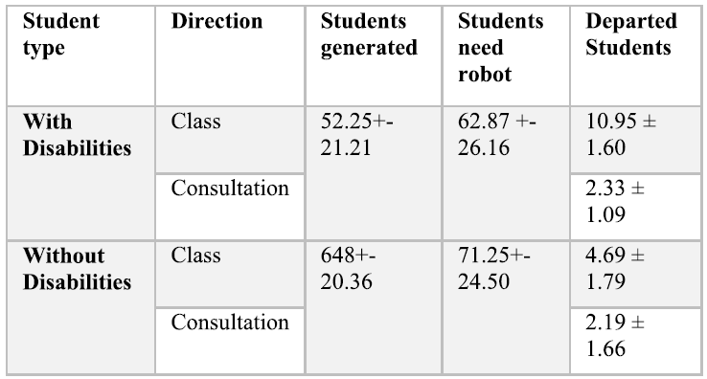
04
Results and interpretation for the second metric
The average number of students served by the robot
Average of 13 students with disabilities
Average of 7 students without disabilities
Success Rate in serving students:
About 30% of students who require assistance received the help they need

Slide 22
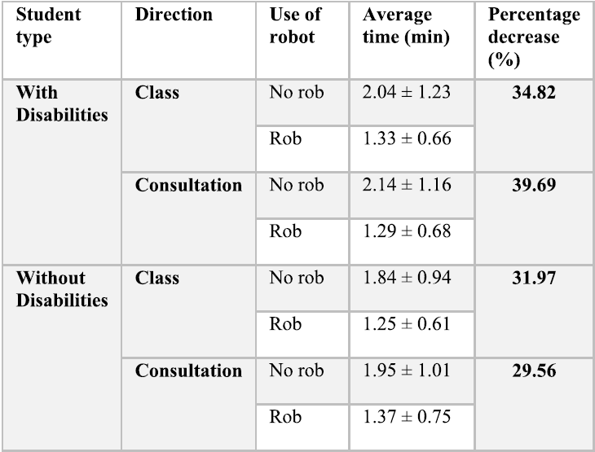
04
Results and interpretation in the second case
The group of disabled students:
Travel time for classes: 35% reduction
Travel time for consultations: 39% reduction
Group of students without disabilities:
Travel time for classes: 31% reduction
Travel time for consultations: 29% reduction

Slide 23
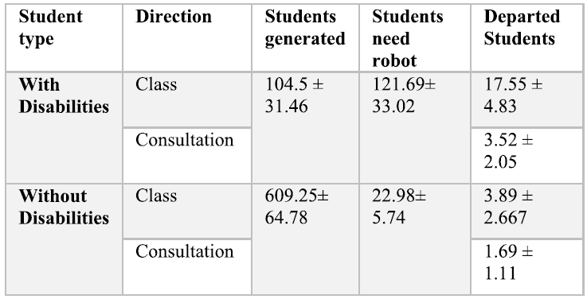
04
Results and interpretation for the second metric
The average number of students served by the robot
Average of 21 students with disabilities
Average of 5 students without disabilities
Success Rate in serving students:
About 18% of students who require assistance received the help they need

Slide 24
04
Potential threats
Interdisciplinary applications of DES mark a meaningful stride but …
Dependency on the accuracy and comprehensiveness of the simulation model
Small discrepancies:
Variations in human behavior
Unforeseen environmental factors
Scalability and adaptability
Replicating success in other buildings
Solutions:
Collaborations with practitioners
Pilot implementations and user feedback
FUTURE WORK
Simulation using multiple robot assistants
The present study can be extended to various universities, hospitals, and other public buildings

Slide 25
References
Y.-J. Chang and T.-Y. Wang, ‘‘Indoor wayfinding based on wireless sensor
networks for individuals with multiple special needs,’’
H. AlMazrua and A. B. Najjar, ‘‘Towards the development of a brain
semi-controlled wheelchair for navigation in indoor environments,’’
P.-J. Duh, Y.-C. Sung, L. F. Chiang, Y.-J. Chang, and K.-W. Chen,
‘‘V-eye: A vision-based navigation system for the visually impaired,’’
G. Delnevo, L. Monti, F. Foschini, and L. Santonastasi, ‘‘On enhancing
accessible smart buildings using IoT,’’
C.-L. Lu, Z.-Y. Liu, J.-T. Huang, C.-I. Huang, B.-H. Wang, Y. Chen, N.-H. Wu, H.-C. Wang, L. Giarré, and P.-Y. Kuo, ‘‘Assistive navigation using deep reinforcement learning guiding robot with UWB/voice beacons and semantic feedbacks for blind and visually impaired people,’’
S. Liu, A. Hasan, K. Hong, C.-K. Yao, J. Lin, W. Liang, M. A. Bayles,
W. A. Rogers, and K. Driggs-Campbell, ‘‘Designing a wayfinding robot
for people with visual impairments,’’
H. S. Grewal, N. T. Jayaprakash, A. Matthews, C. Shrivastav, and
K. George, ‘‘Autonomous wheelchair navigation in unmapped indoor environments,’’
N. S. M. Yusoff, C.-Y. Liong, A. Y. M. Noh, and W. R. Ismail, ‘‘Discrete
event simulation and data envelopment analysis models for selecting the
best resource allocation alternative at an emergency department’s green
zone,’’
M. Zouri, C. Cumpat, N. Zouri, M.-M. Leon, A. Mastaleru, and A. Ferworn, ‘‘Decision support for resource optimization using discrete event simulation in rehabilitation hospitals,’’
S. Robinson, ‘‘Conceptual modeling for simulation,’’

Slide 26
THANK YOU
Sina Beyrami
Sharif University of Technology
400105433

